Slide 1


ACTIVITY
Design Choices
Find the two visuals for your team.
In groups look at two visualisations. Make notes on what went wrong. Think about:
Ability to take away key information
Colour choices
Type of graph choice
Labelling of x/y axis
Grouping of data
The thing that’s stressed the most in the chart
Consistency

Slide 2
Team 1

Slide 3
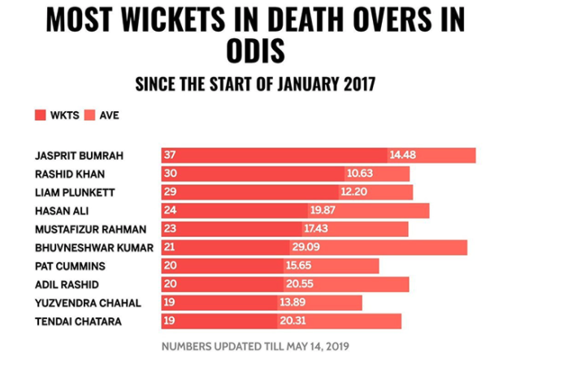
The bar chart represents the wickets and batting averages of cricket players.

Slide 4
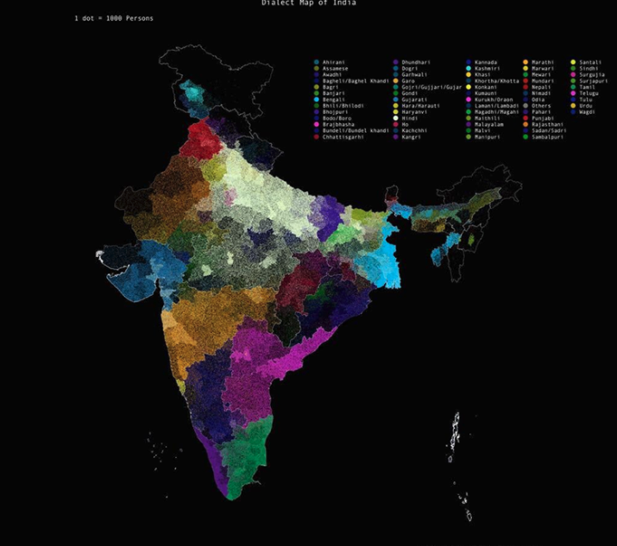
Dialect Map of India

Slide 5
Team 2

Slide 6
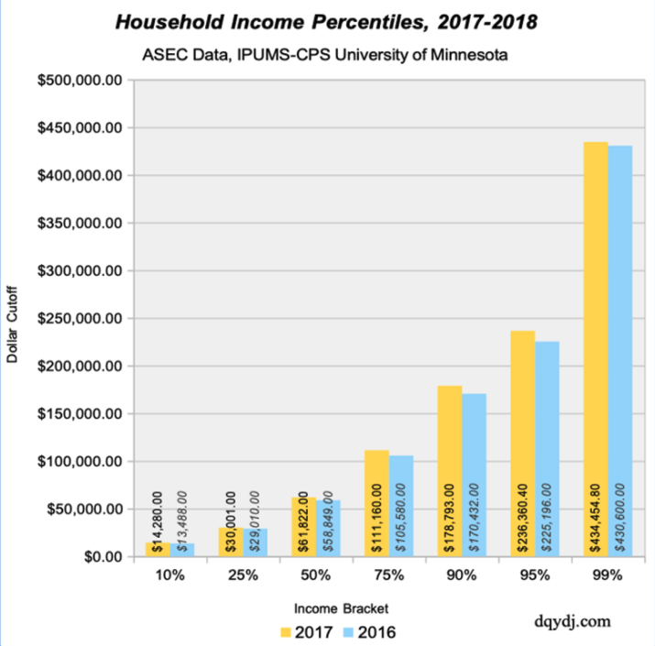
ASEC data, household income percentiles

Slide 7
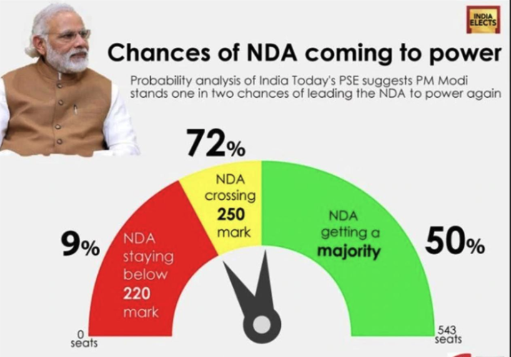
Chances of Prime Minister Narendra – NDA – Modi winning a second term.

Slide 8
Team 3

Slide 9
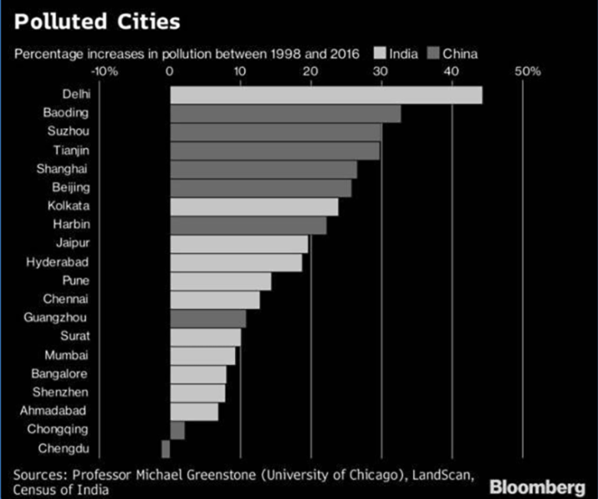
Increase in pollution in Cities in India and China

Slide 10
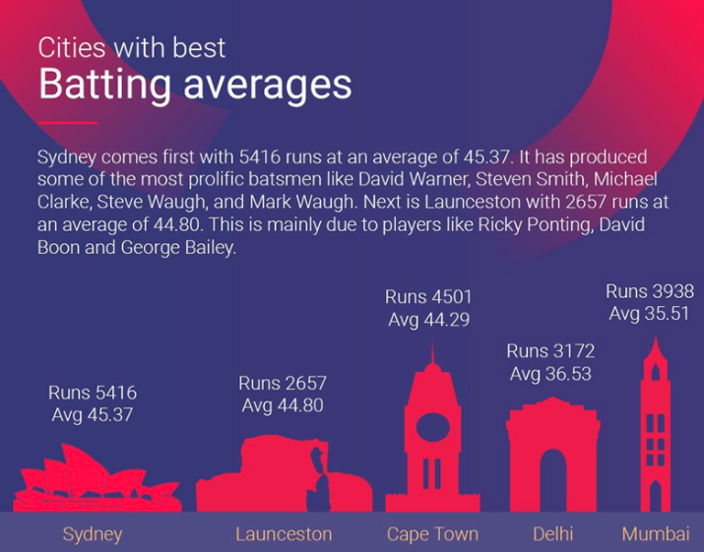
Cricket information by city

Slide 11
Team 4

Slide 12
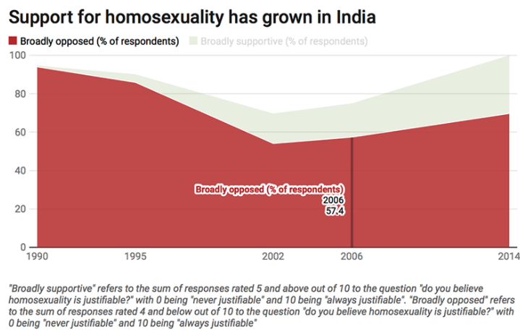
Opposition and Support of homosexuality in India

Slide 13
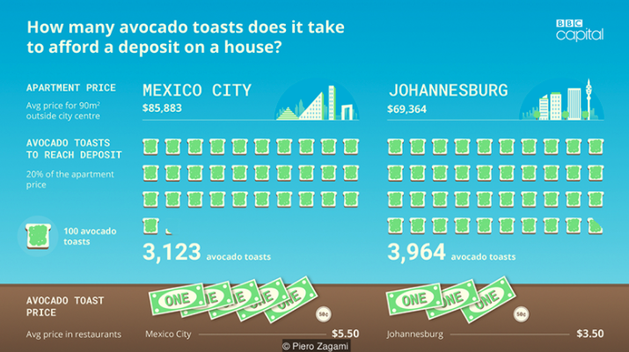
The Avocado Toast Index article
https://www.bbc.com/worklife/article/20170530-the-avocado- toast-index-how-many-breakfasts-to-buy-a-house

